Slide 1

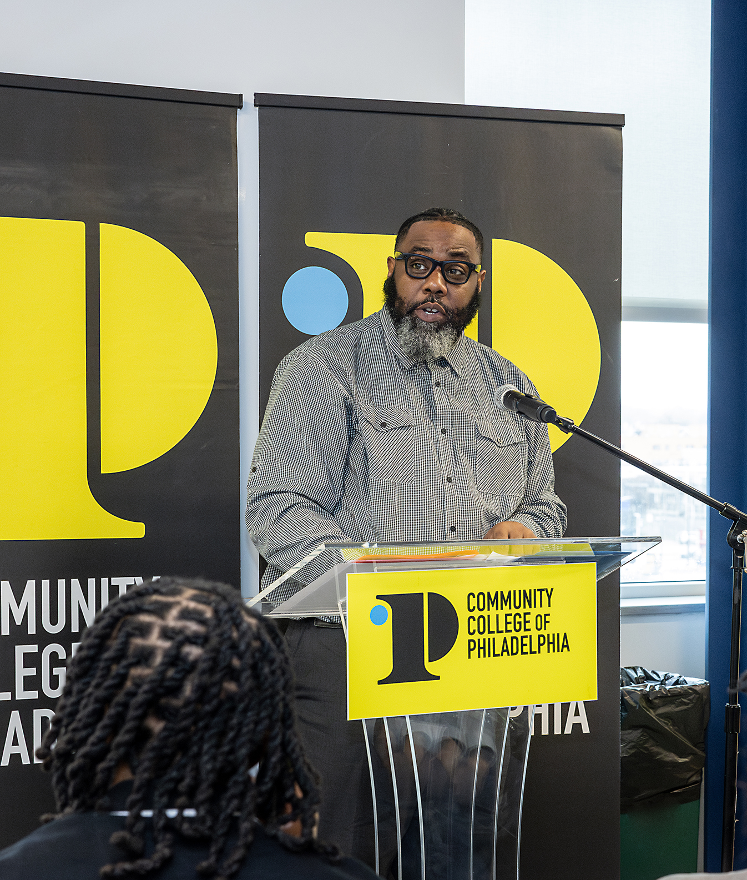
Success at CCP
May 5, 2026

Slide 2

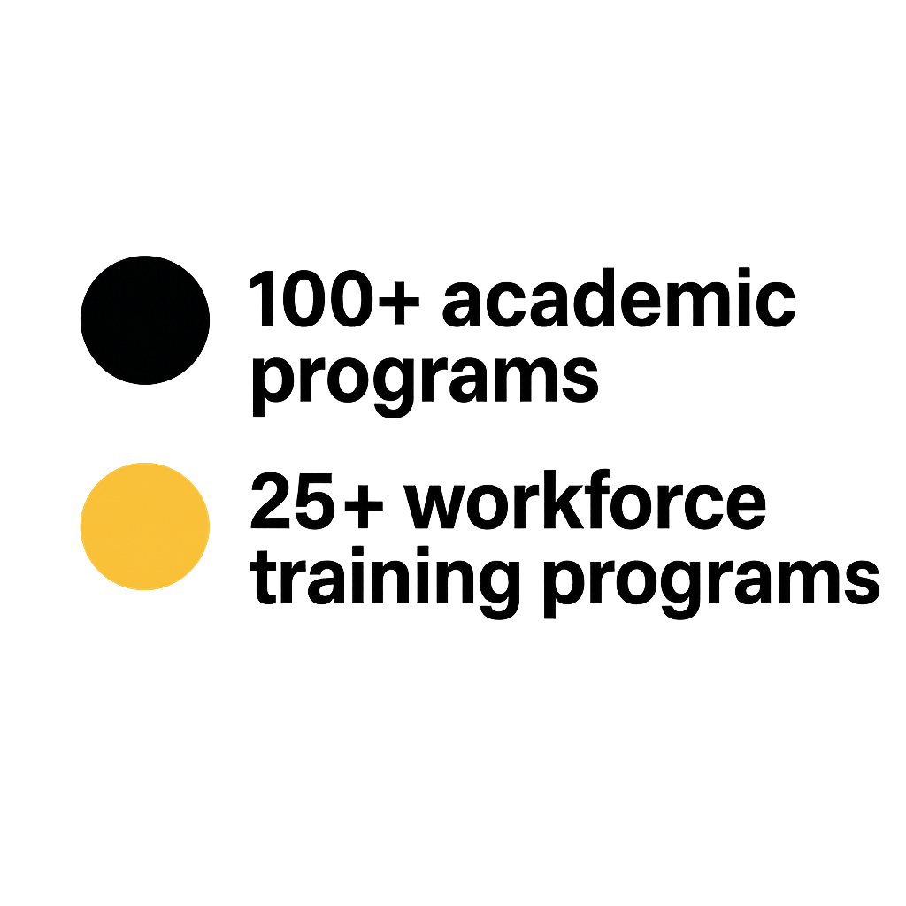
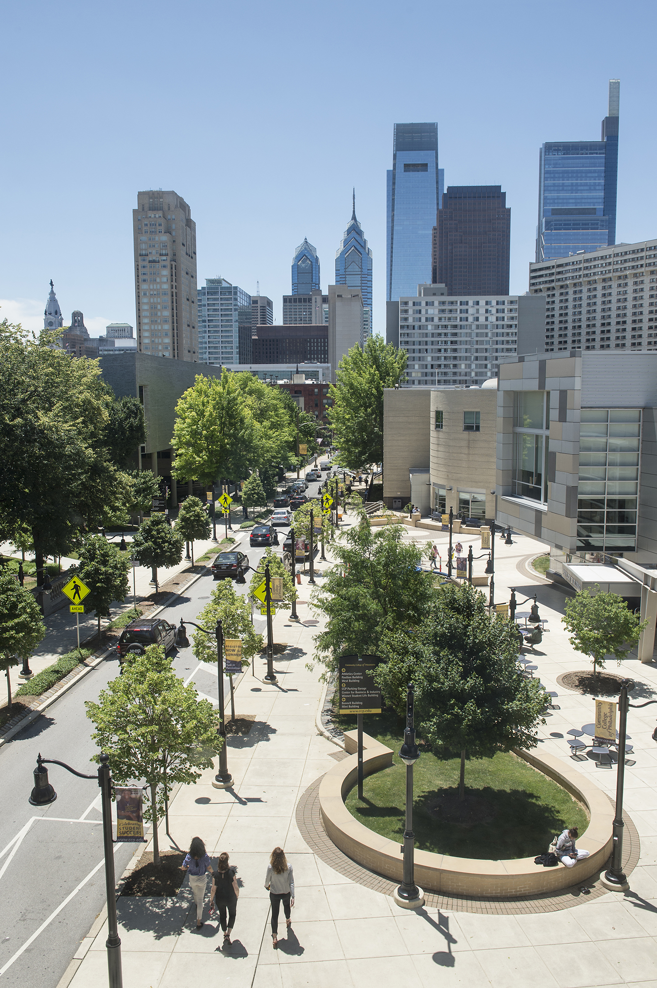
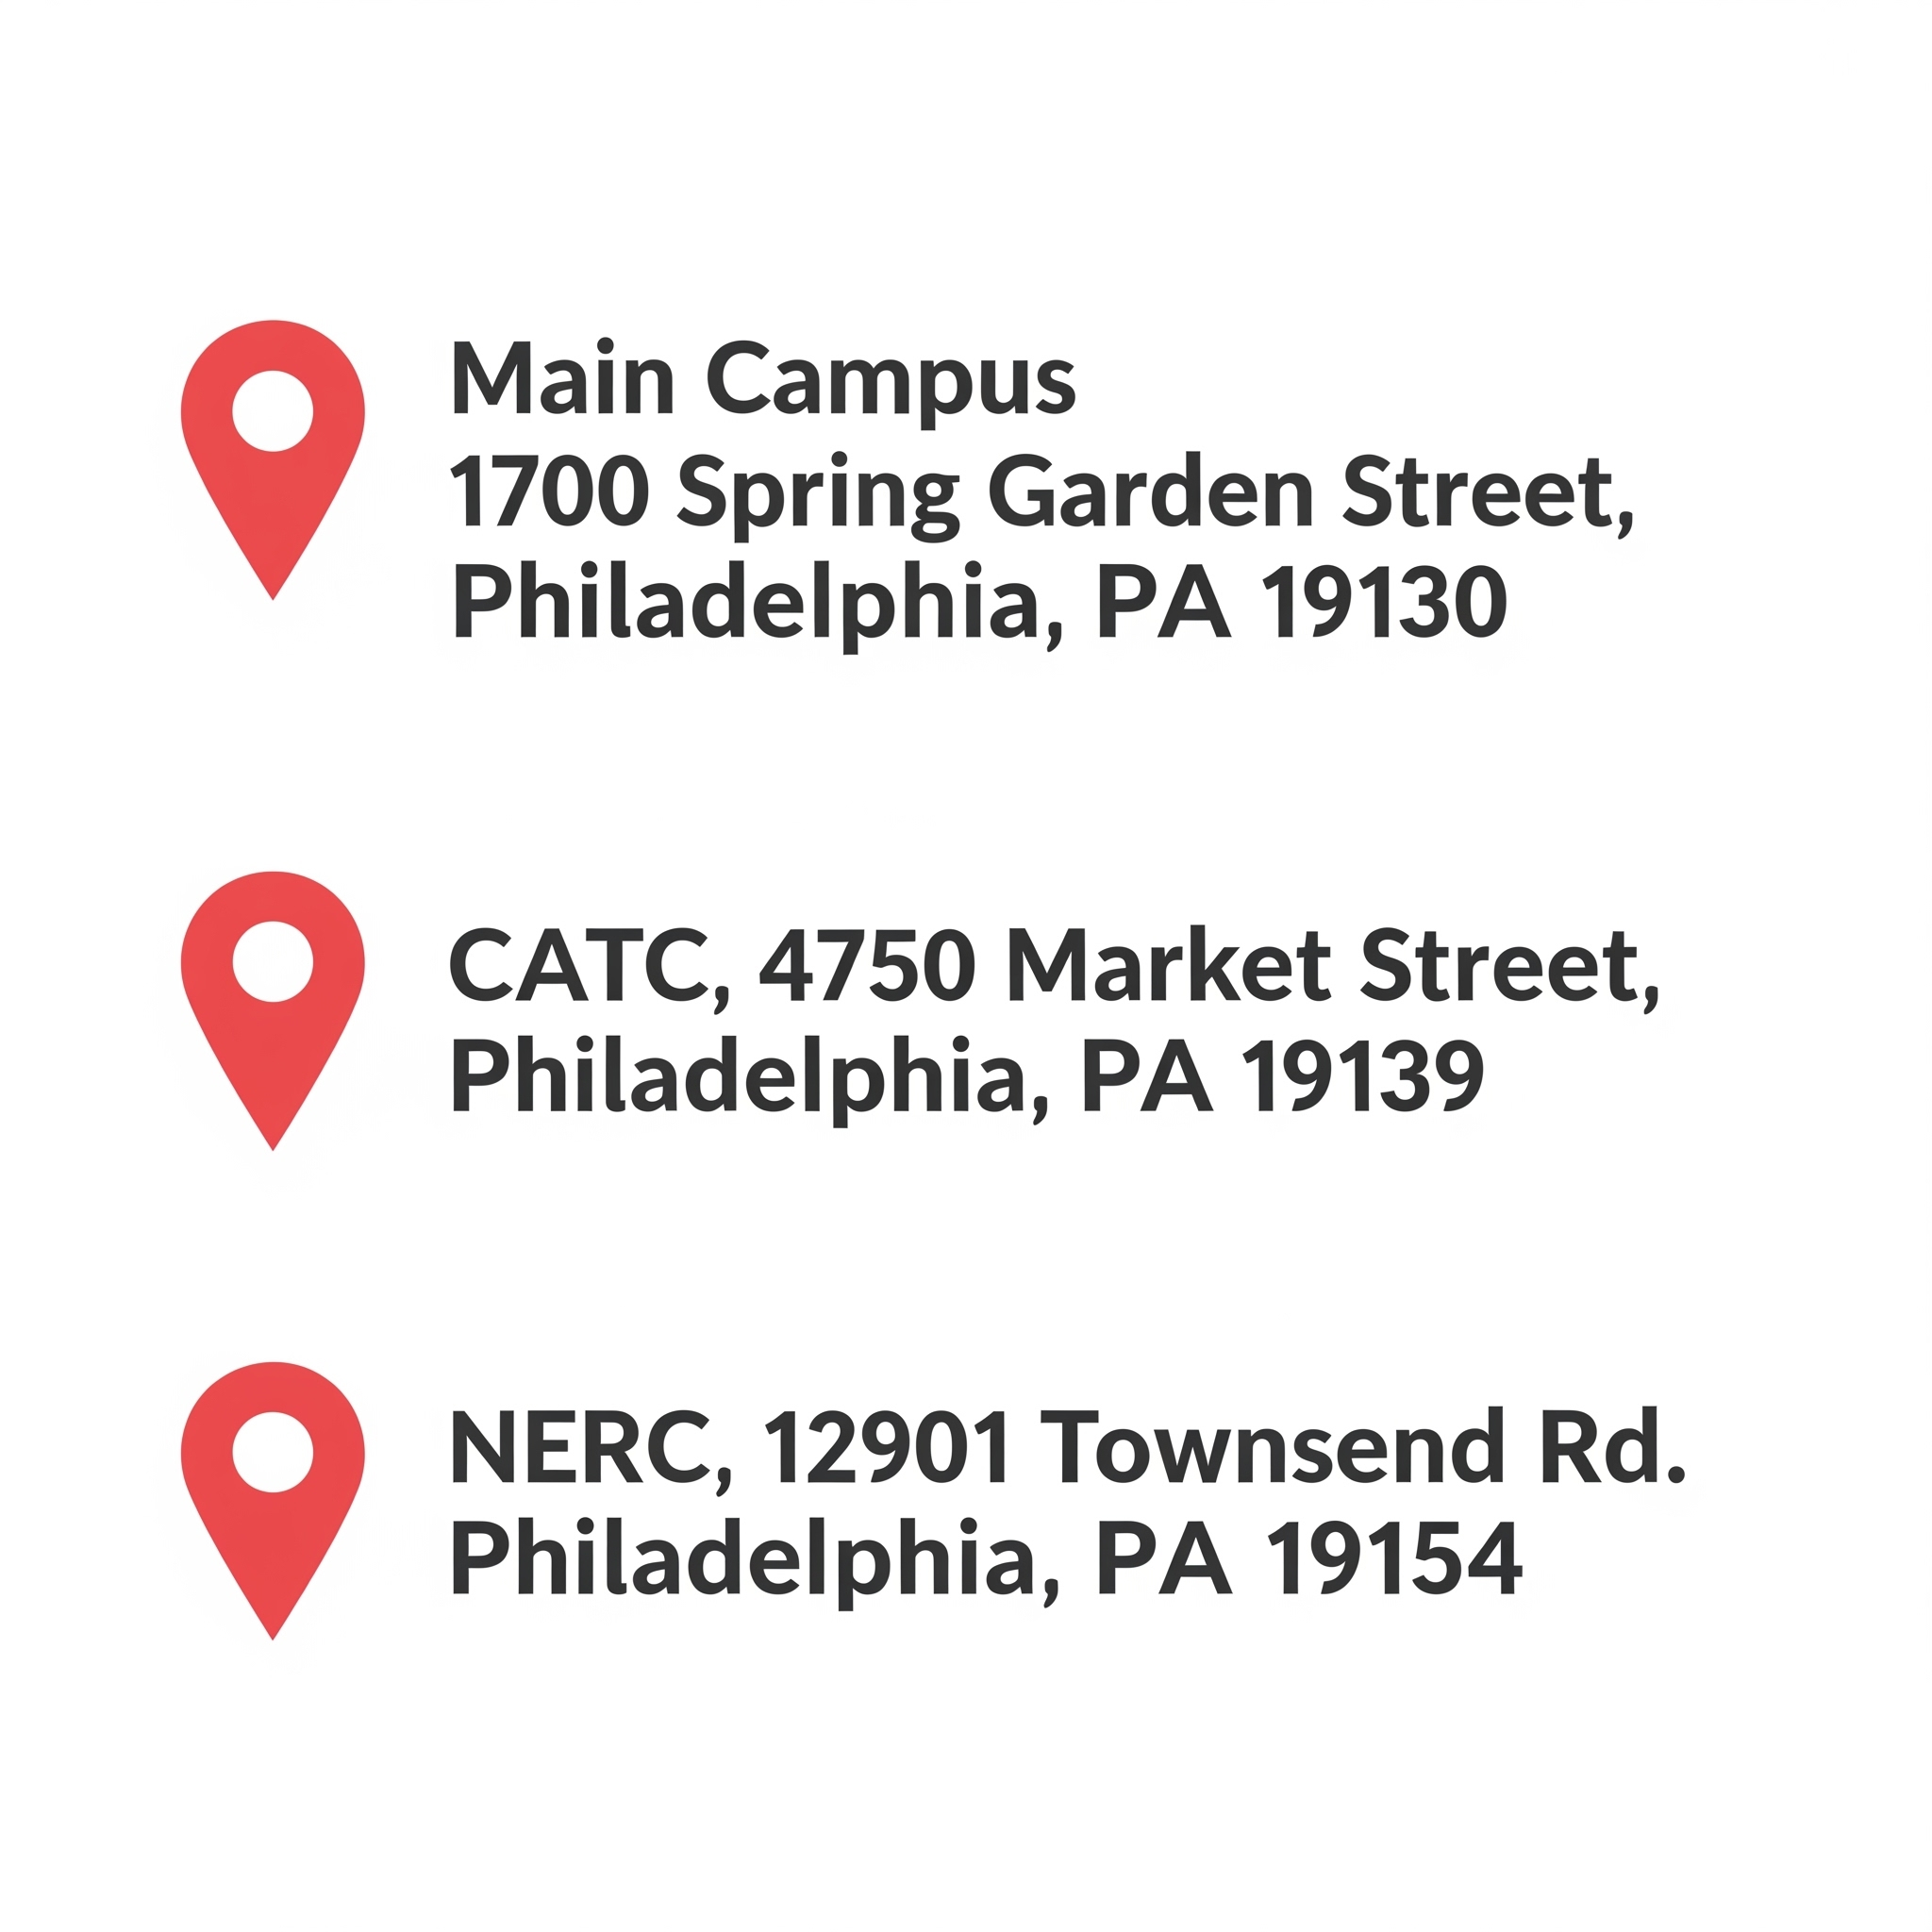
21,067 students
College at a Glance
1,700+
dual enrolled
54%
Pell
66%
part-time

Slide 3

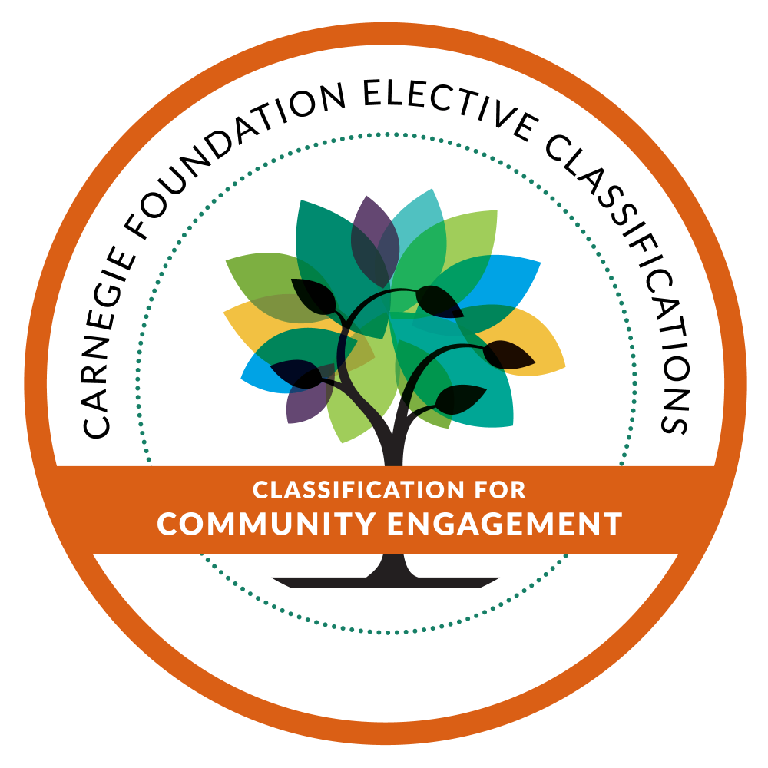


National recognition

Slide 4
CCP generates nearly
$1 billion
In annual economic activity
Through direct, indirect, and capital spending of which
$882 million
benefits Philadelphia's economy

Slide 5
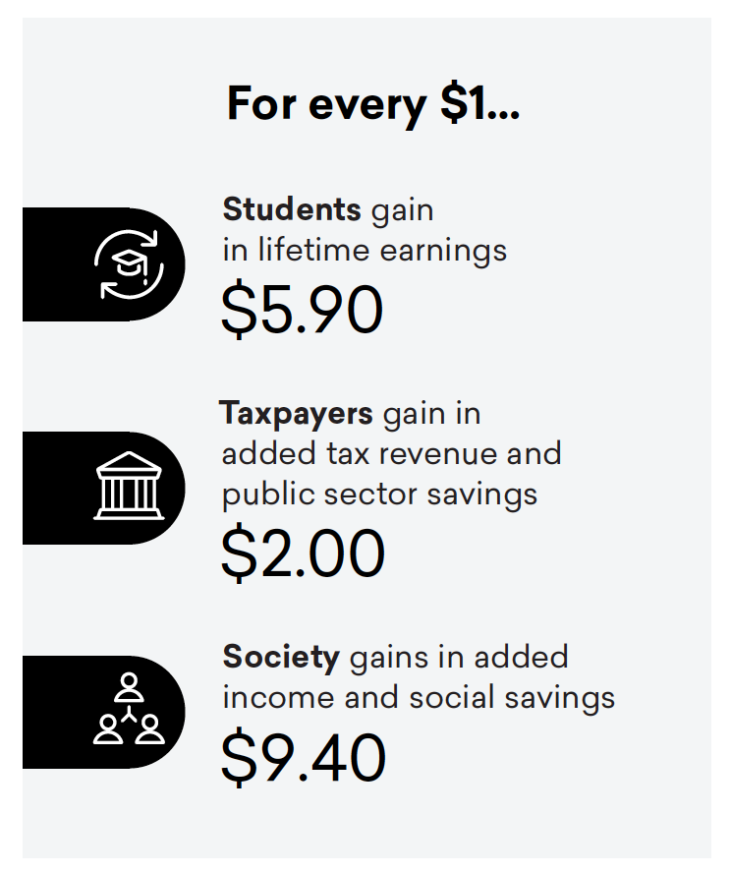
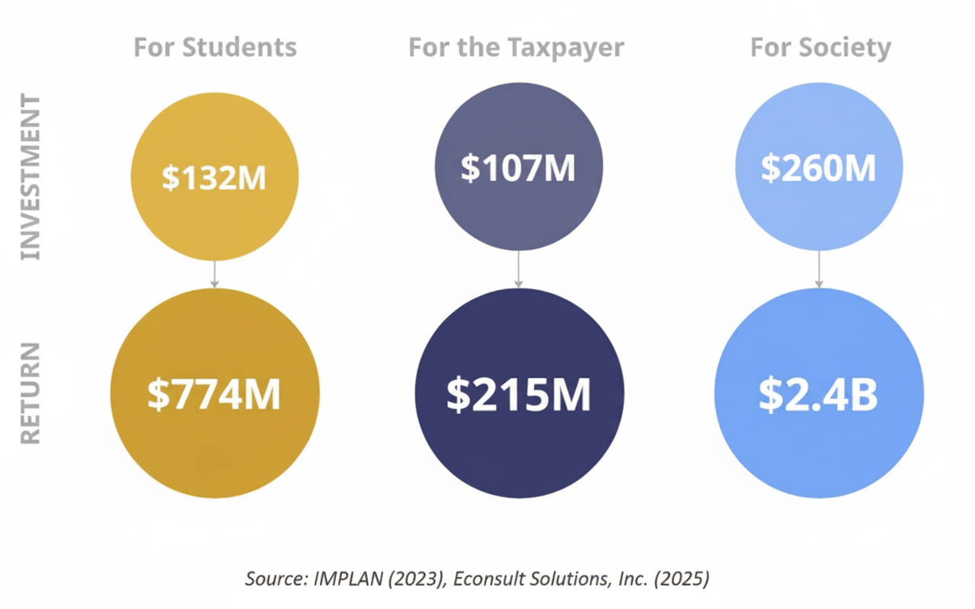
Economic impact
Associate degree holders earn 18% more than those who only complete high school

Slide 6





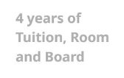
Top Ten Transfer Institutions
2016-2026
Temple University 4669 Students
Drexel University 1676 Students
West Chester University 892 Students
La Salle University
Holy Family University
Penn State University
Thomas Jefferson University - East Falls Peirce College
Chestnut Hill College
Thomas Jefferson University - Nursing
Transfer savings
$109K
$203K
$100K
$88K
$158K
$345K
$140K
$115K
98% of Community College graduates remain in Philadelphia

Slide 7
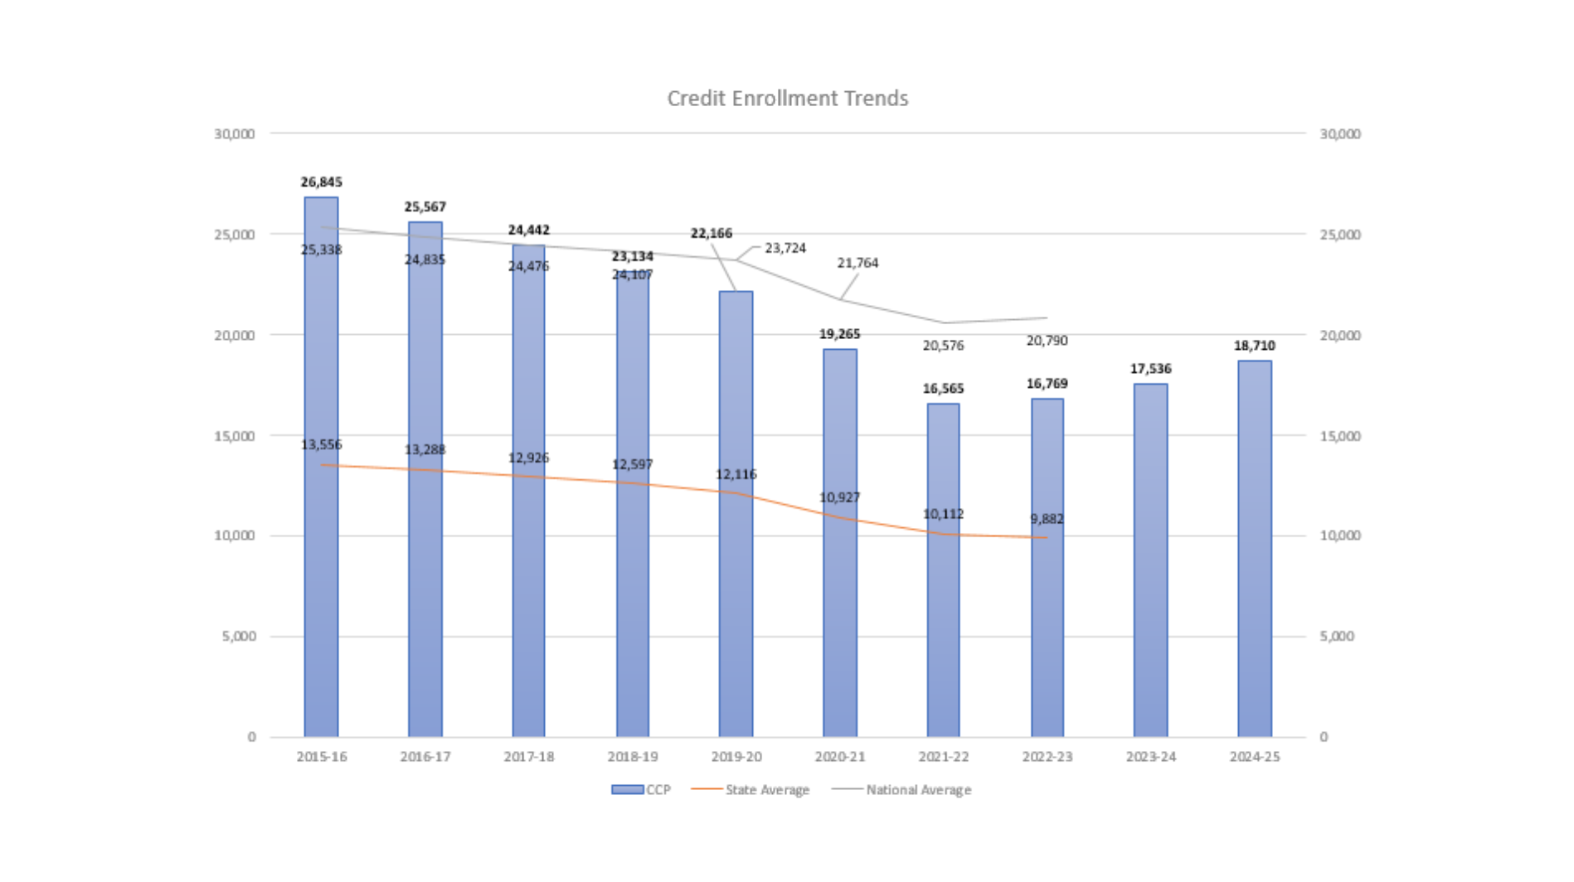

Slide 9
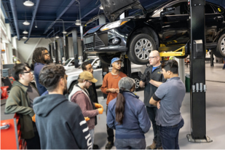
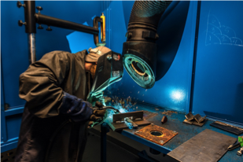
CATC
CATC is newest location, opened in 2022
Doubled enrollment year over year
Most popular programs include automotive technology, healthcare and medium and heavy truck technologies
Earn and learn Toyota T-10
$2.7M grant from U.S. Navy for Naval Welding and Non-Destructive Testing program launch

Slide 10
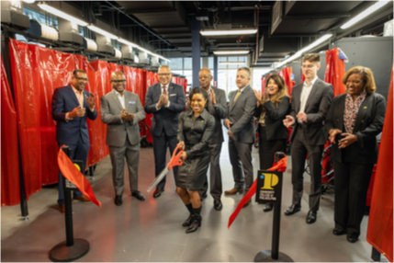

Maritime Industrial Base Initiative
Hanwha Philly Shipyard Student Visit: Feb 17, 2026
Graduation and Naval Welding Lab ribbon-cutting: 22 graduates

Slide 11
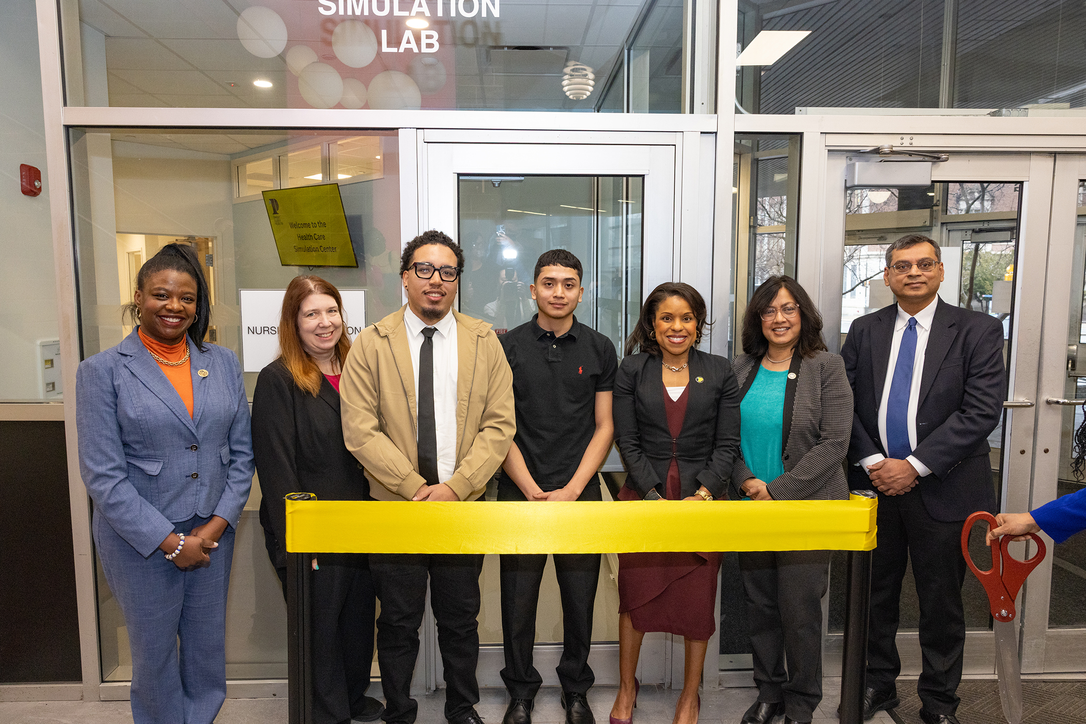
Health & Wellness Workforce Impact
High-demand pathways supporting Philly’s care economy:
Nursing
Clinical Medical Assisting
Pharmacy Tech
Dental Hygiene
Nurse-Aid
➡️ CCP is scaling the healthcare workforce pipeline to meet regional demand

Slide 12
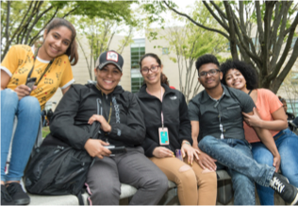
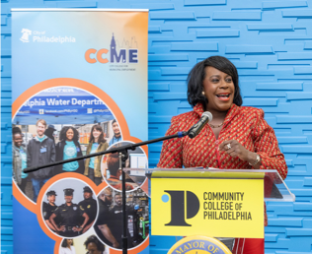
Strategic Partnerships
CCME: To date, over 400 residents have enrolled and over 80 have completed the program
Dual Enrollment: 10% of CCP student population
Octavius Catto Scholarship: 4,000 low-income residents supported with wrap-around services
Outcomes: Catto Scholars have graduated at double the rates of their comparison group.
At least 60% of graduates have transferred to four-year institutions.

Slide 13
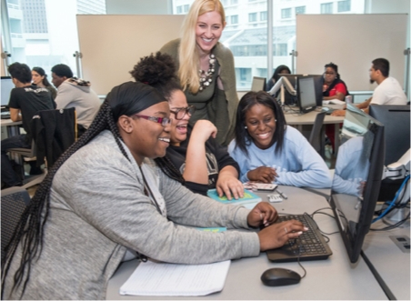
Growing Teacher Pipeline
Philly Catto Teacher Scholars (40)
Holy Family
LaSalle
Temple (20)
Arcadia
Cheyney @ CCP (30)
Para Pathway Program (24)

Slide 14
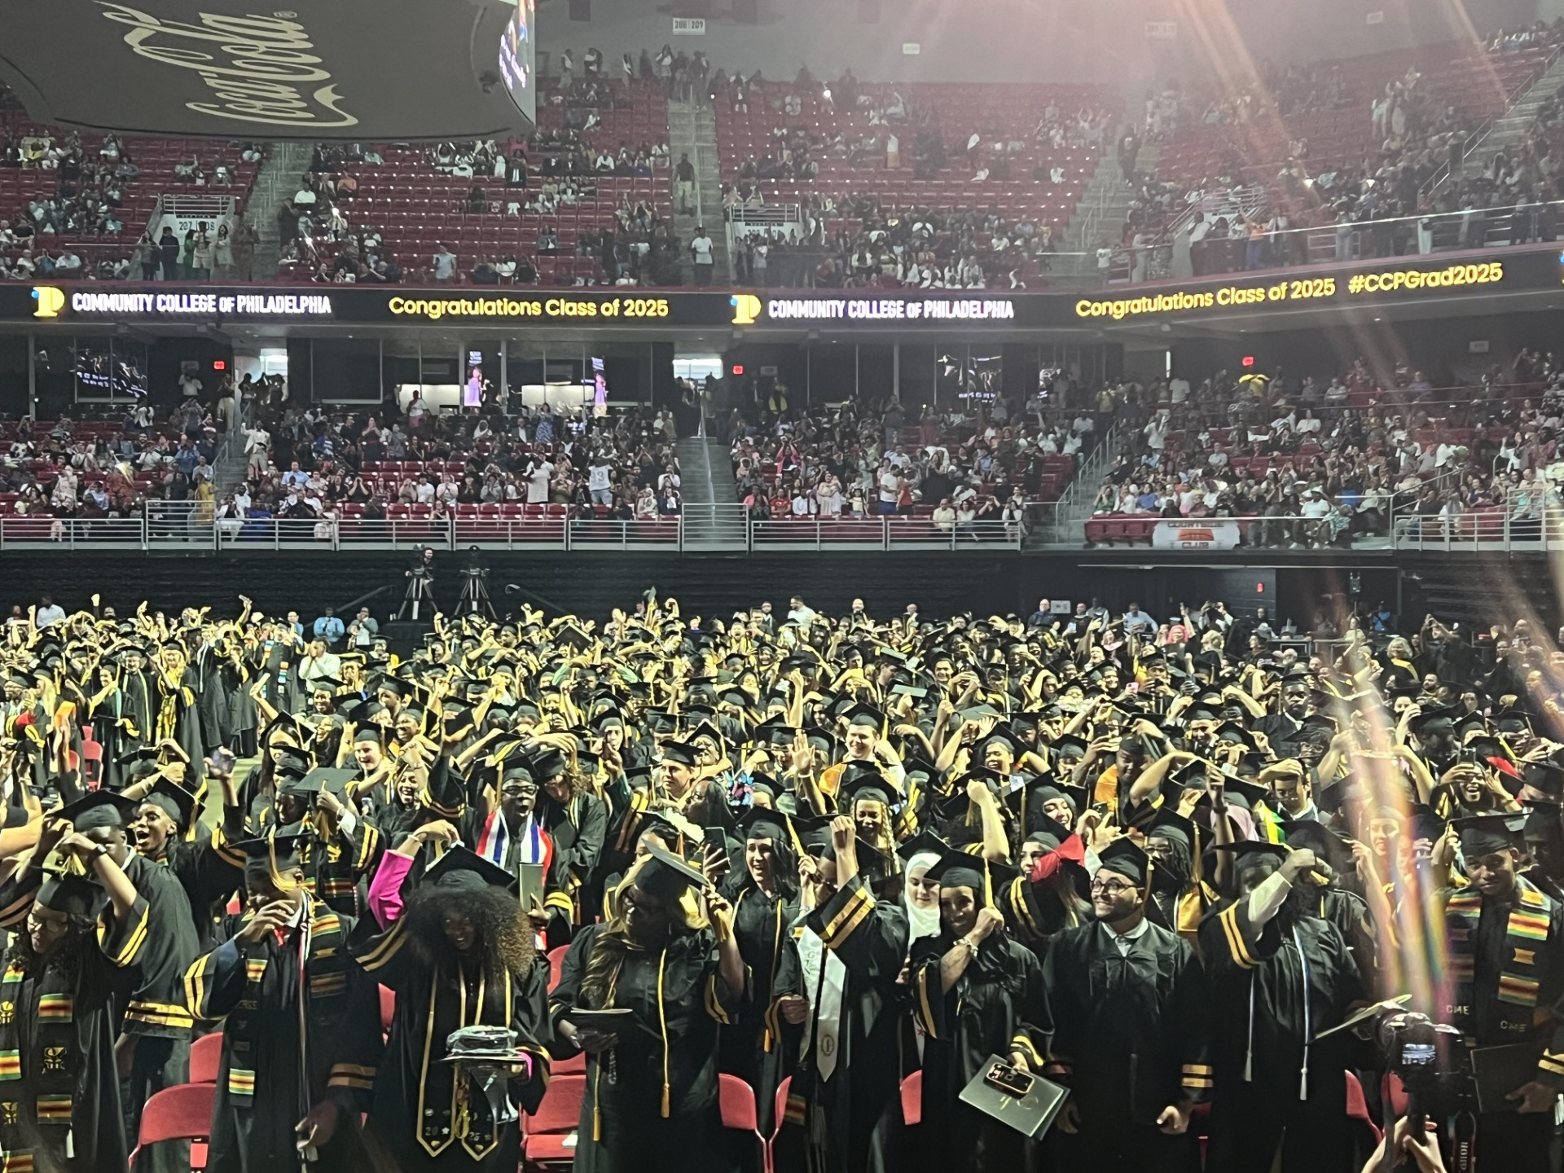
Thank you!

