Slide 1

^{THE PHILADELPHIA}
^{ENERGY CAMPAIGN}
^{A PLATFORM FOR JOB CREATION,}
ENERGY EFFICIENCY, AND CLEAN ENERGY

Slide 2

^{CAMPAIGN GOALS}

Slide 3
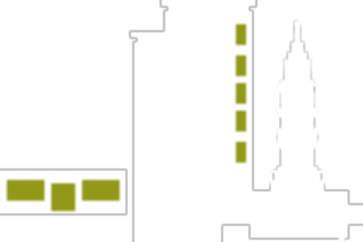



¹
^{MUNICIPAL BUILDINGS}
²
^{K-12}
^{SCHOOLS}
³
^{LOW-INCOME}
^{RESIDENTIAL}
⁴
^{SMALL}
^{BUSINESS}

Slide 4
^{CAMPAIGN TASKS}
¹
NETWORK THE BUILDING ENERGY STAKEHOLDERS
SUPPORT MARKET INFRASTRUCTURE TO GROW A $1 BILLION PIPELINE OF ^{PROJECTS}
²
³
^{BUILD CAPACITY TO FINANCE}
^{$1 BILLION OF ENERGY PROJECTS}

Slide 5
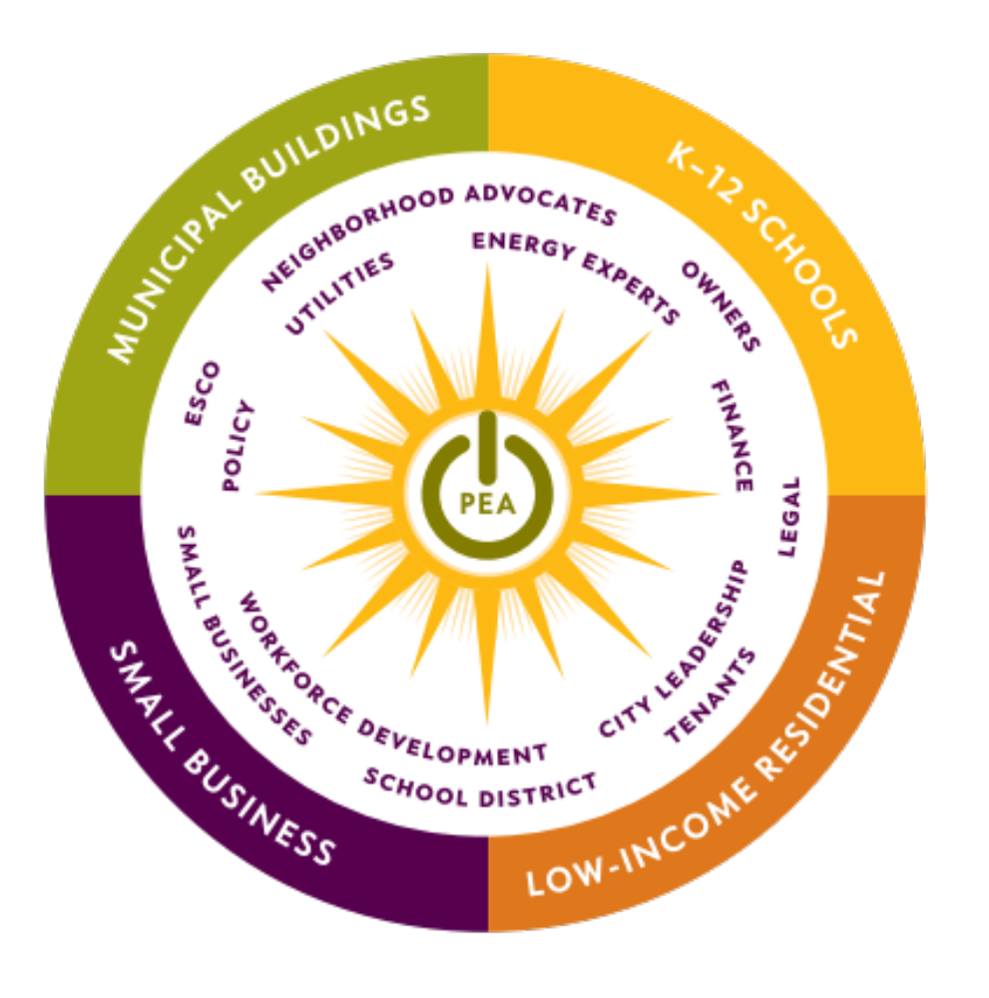
^{A BROAD COALITION}

Slide 6

^{SAVINGS}
$200M SAVINGS
RETURNED
TO THE LOCAL ECONOMY

Slide 7
^{THE PHILADELPHIA}
^{ENERGY CAMPAIGN}
^{A PLATFORM FOR JOB CREATION,}
ENERGY EFFICIENCY, AND CLEAN ENERGY

